Slide 1

Cataract detection and grading
Guide: Dr. Sagarika Bora

Slide 2
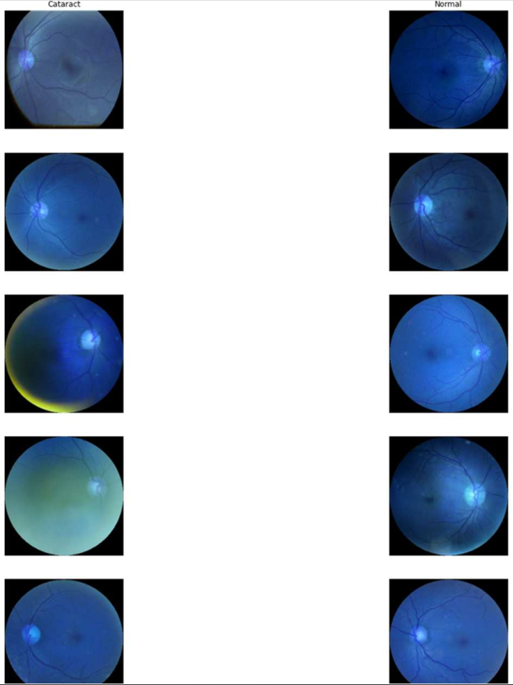
Abstract
Cataract is one of the most prevalent causes of blindness in the modern society, accounting for 50% of blindness. According to a survey done by WHO/NPCB there is a backlog of over 22 million blind eyes (12 million blind people) in India. 80.1% of these are blind due to cataract. The annual incidence of cataract blindness is about 3.8 million. Early detection and treatment can reduce the suffering and prevent visual impairment from turning into blindness. But the expertise needed for early detection and grading is down to availability of expert trained eye specialist which may not be available in rural parts of the country. Existing studies on automatic detection and grading based on fundus images utilizes a predefined set of images provide an incomplete, redundant or noisy representation. In this project, the aim is to use Deep Convolutional Neural Network (DCNN) to detect and grade cataract automatically. This will help in early detection of cataract even without the presence of an trained eye specialist in some of the remote parts of the country.

Slide 3
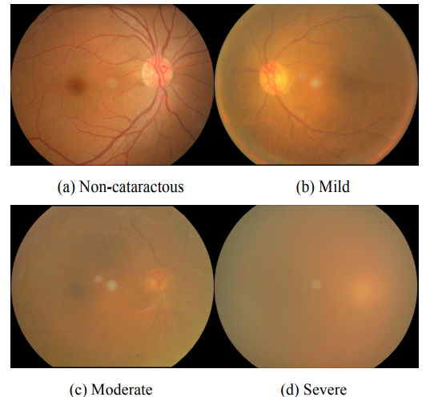
OBJECTIVE: Cataract Detection and Grading using Deep Convolutional Neural Network.
RATIONALE: The Rationale to opt for this Topic:
-> Early Detection and treatment for Cataract.
-> Prevention from permanent blindness.
PROBLEM STATEMENT:
Cataract is the lead cause of blindness in the country and worldwide accounting for 80.1% in India and 50% around the world. Lack of trained expert in remote locations makes it difficult to detect and treat cataract, using DCNN to create an automated detection and grading model would help in reducing the chances of blindness to people even in the most remote parts of the world/country where presence of trained expert is not possible.

Slide 4
Reference: https://www.kaggle.com/jr2ngb/cataractdataset
Cataract is the leading cause of blindness in the country.
Cataract is mainly graded into four grades:
GRADE I: Mild
GRADE II: Moderate
GRADE III: Pronounced
GRADE IV: Severe
Use of Deep Convolutional Neural Network to detect Cataract and Grade them according to their severeness to kick start the treatment to prevent blindness.

Slide 5
AUTHORS | CITATION | PRE-PROCESSING | REVIEW
Linglin Zhang, Jianqiang Li, i Zhang, He Hana, Bo Liua, Jijiang Yangc, Qing Wang | Automatic Cataract Detection And Grading Using Deep Convolutional Neural Network | Unify fundus images and Erase patients personal information | Deep Convolutional Neural Network and visualize some feature maps at pool5 layer.
Jocelyn Hui Lin Goh, Zhi Wei Lim, Xiaoling Fang, Ayesha Anees, Simon Nusinovici, Tyler Hyungtaek Rim, Ching-Yu Cheng, Yih-Chung Tham | Artificial Intelligence for Cataract Detection and Management | Excluding ungradable photos and photos with error in lens location detection. | Application of AI for the IOL power calculation.
Xinting Gao, Stephen Lin, Tien Yin Wong | Automatic Feature Learning to Grade Nuclear Cataracts Based on Deep Learning | Adopt the deep learning framework based on convolutional-recursive neural networks (CRNN). | Proposed a new method for nuclear cataract grading based on automatic feature learning
Md. Sajjad Mahmud Khan, Mahiuddin Ahmed, Raseduz Zaman Rasel, Dr. Mohammad Monirujjaman Khan | Cataract Detection Using Convolutional Neural Network with VGG-19 Model | Filtered out all fundus images other than Cataract and Normal Fundus Images | Automated cataract detection system utilizing convolutional neural networks with transfer learning approach
Masum Shah Junayed, MD Baharul Islam, Arezoo Sadeghzadeh, Saimunur Rahman | CataractNet: An Automated Cataract Detection System Using Deep Learning for Fundus Images | The images are resized to a unified format with 224 × 224 pixels. | Presented an automated cataract detection system, namely CataractNet, based on lightweight deep learning

Slide 6
Research Papers
https://ieeexplore.ieee.org/stamp/stamp.jsp?tp=&arnumber=8000068
https://ieeexplore.ieee.org/stamp/stamp.jsp?tp=&arnumber=8261463
https://journals.lww.com/apjoo/fulltext/2020/04000/artificial_intelligence_for_cataract_detection_and.6.aspx
https://ieeexplore.ieee.org/stamp/stamp.jsp?tp=&arnumber=7122265
https://ieeexplore.ieee.org/stamp/stamp.jsp?tp=&arnumber=9454244

